Slide 1

Linking the performance of a data-limited empirical catch rule to life-history traits
updates for WKLIFE IX
Simon H. Fischer^{1,2}, José A. A. De Oliveira¹, Laurence T. Kell²
¹ Centre for Environment, Fisheries and Aquaculture Science (Cefas), UK
² Centre for Environmental Policy, Imperial College London, UK
simon.fischer@cefas.co.uk
World Class Science for the Marine and Freshwater Environment

Slide 2
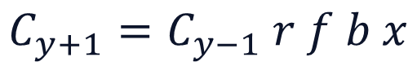
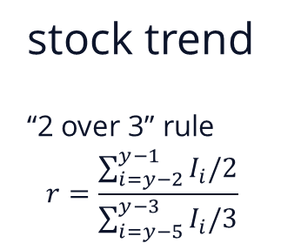
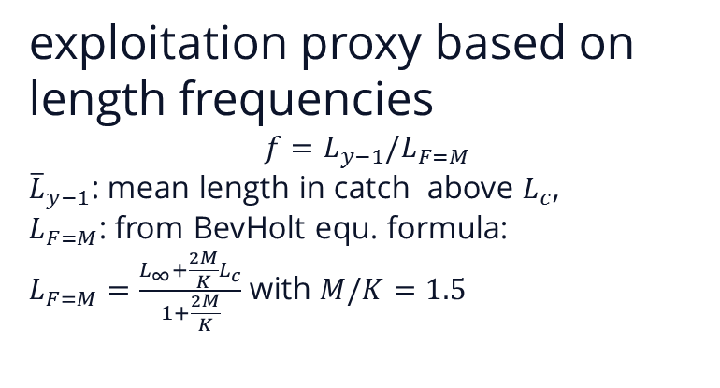
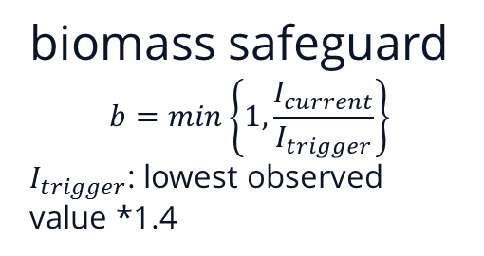
Test simple empirical catch rule
catch rule 3.2.1 from ICES WKMSYCat34
optional multiplier
stock trend
“2 over 3” rule
exploitation proxy based on length frequencies
: mean length in catch above ,
: from BevHolt equ. formula:
with
biomass safeguard
: lowest observed value *1.4

Slide 3
MSE simulation
MSE with Fisheries Library in R (FLR);
simulated 29 data-limited fish stocks based life-history with Flife
input parameters:
von Bertalanffy growth parameters (k, L_{inf}, t₀)
length weight parameters (a, b)
age/length at 50% maturity (a₅₀)
Beverton-Holt stock recruitment, constant steepness h=0.75
age structured operating model
fully stochastic MSE simulation, 500 replicates, 100 year projection
wide range of stocks & life-histories covered

Slide 4
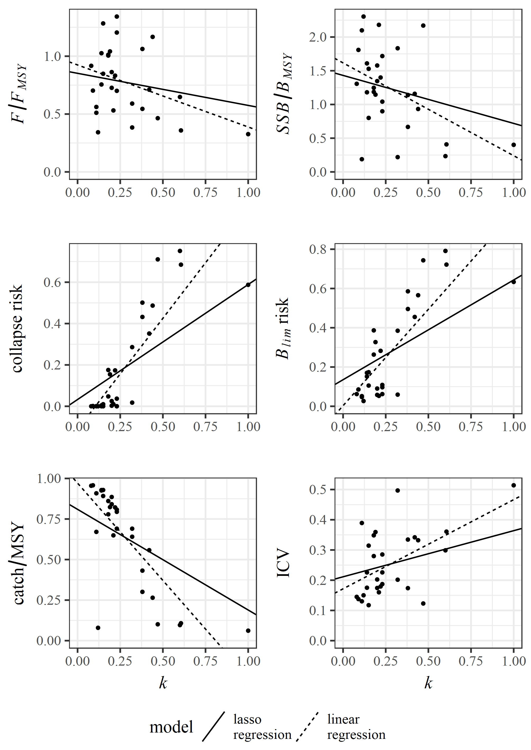
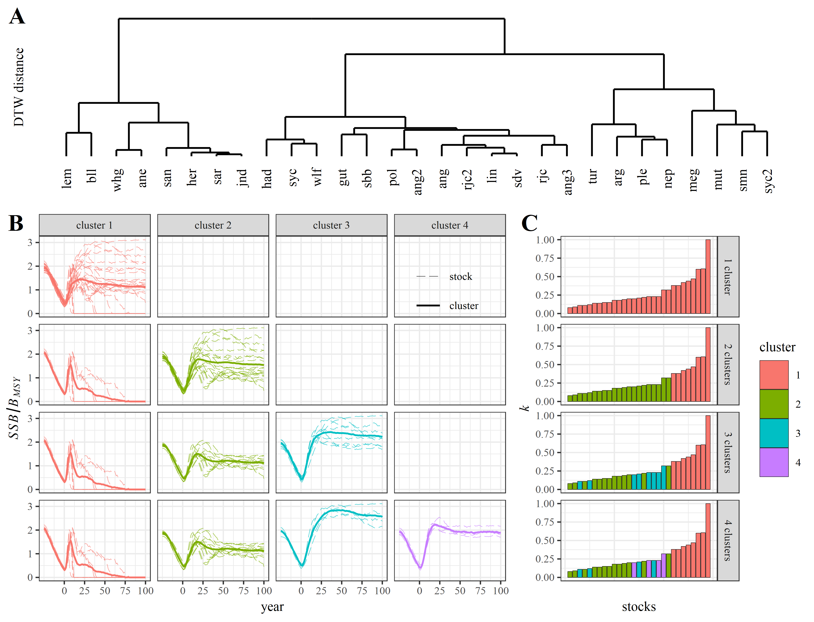
Main results
time-series clustering of SSB/B_{MSY}
clusters at ~0/1/2/3 B_{MSY}
stocks with k≥0.38 always collapsed
penalised regression model
k most important

Slide 5
paper submitted to ICES Journal of Marine Science
issues raised (I):
constant steepness h=0.75, should be species specific
result counter-intuitive, higher k stocks have higher risks & lower SSB/B_{MSY}, F/F_{MSY}, catch/MSY & no discussion about that

Slide 6
response 1
issues raised (I):
constant steepness h=0.75, should be species specific
result counter-intuitive, higher k stocks have higher risks & lower SSB/B_{MSY}, F/F_{MSY}, catch/MSY & no discussion about that
MSE results emergent properties of interaction OM vs MP
this in the reason for running an MSE…
the paper is about linking performance to life-history

Slide 7
response 1
issues raised (I):
constant steepness h=0.75, should be species specific
more scenarios:
higher steepness h=0.9
higher recruitment uncertainty, double sd=0.3 to sd=0.6

Slide 8
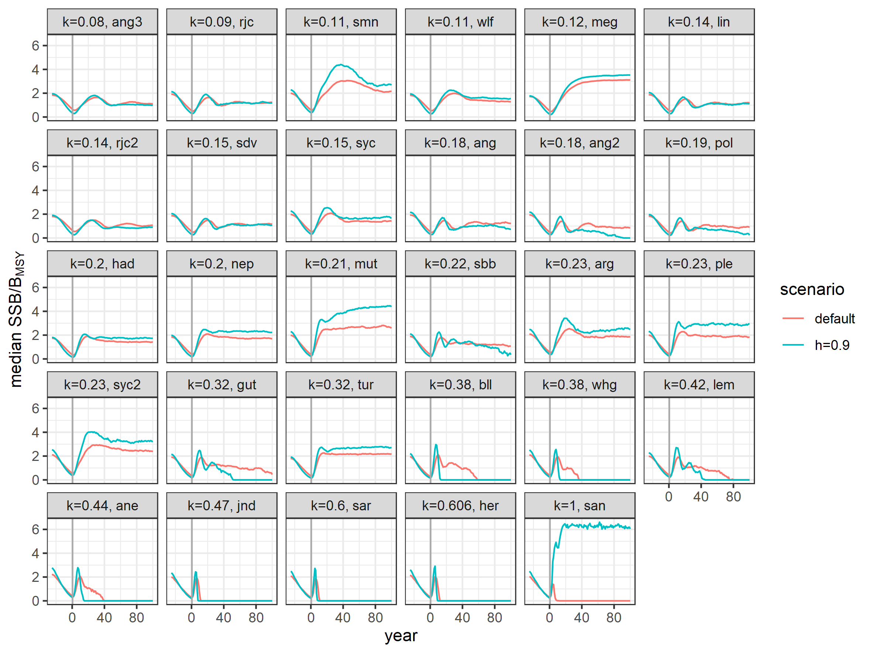
response 1
issues raised:
constant steepness h=0.75, should be species specific
more scenarios:
higher steepness h=0.9
higher recruitment uncertainty, double sd=0.3 to sd=0.6

Slide 9
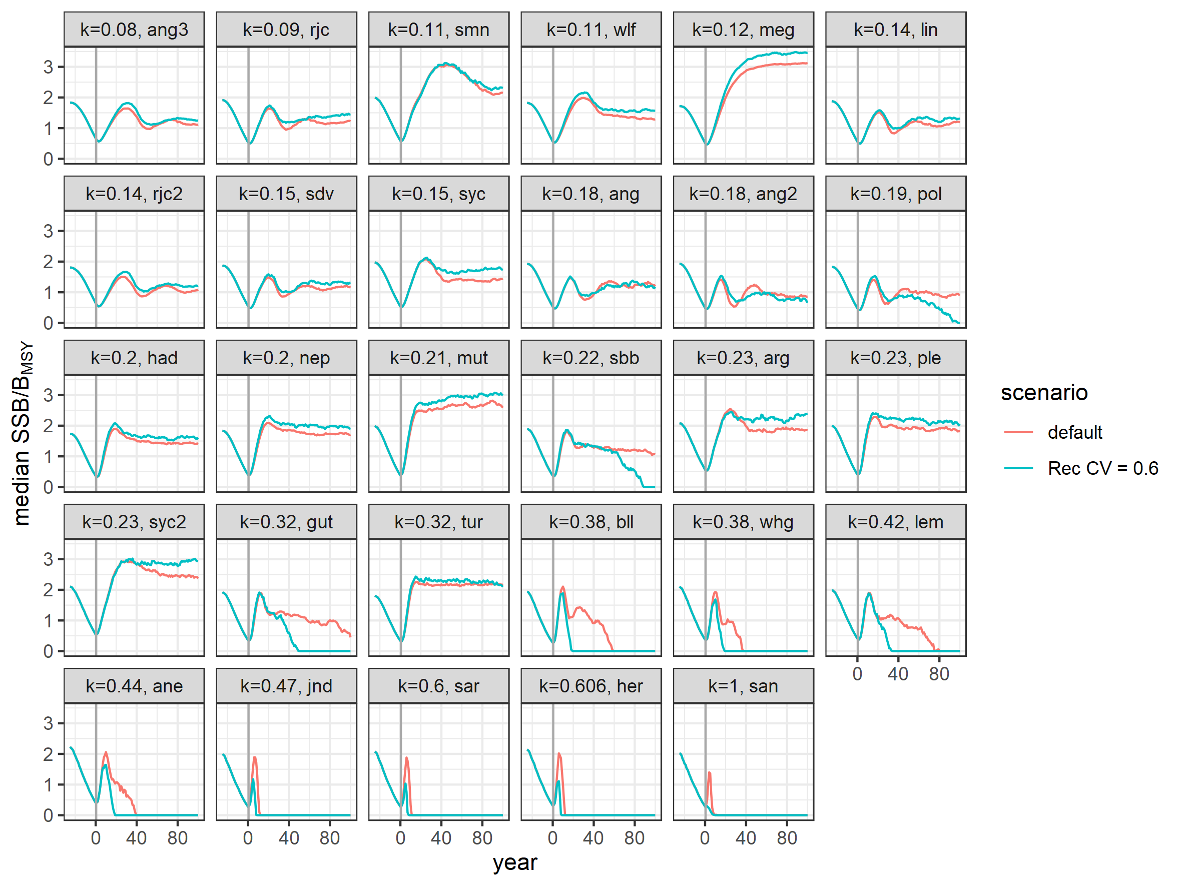
response 1
issues raised:
constant steepness h=0.75, should be species specific
more scenarios:
higher steepness h=0.9
higher recruitment uncertainty, double sd=0.3 to sd=0.6

Slide 10
response 1
issues raised:
constant steepness h=0.75, should be species specific
more scenarios:
higher steepness h=0.9
higher recruitment uncertainty, double sd=0.3 to sd=0.6

Slide 11
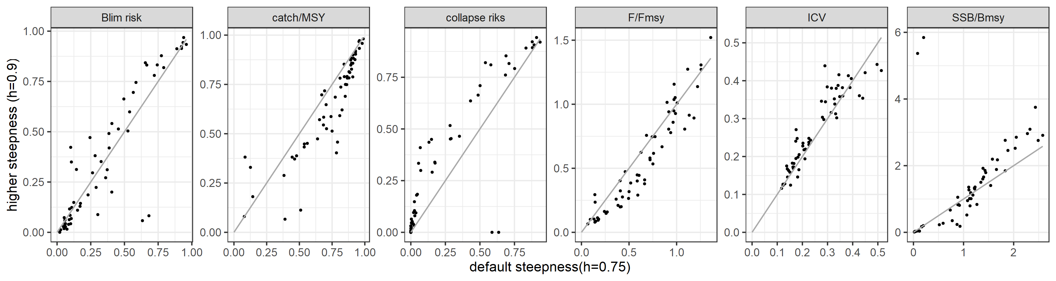
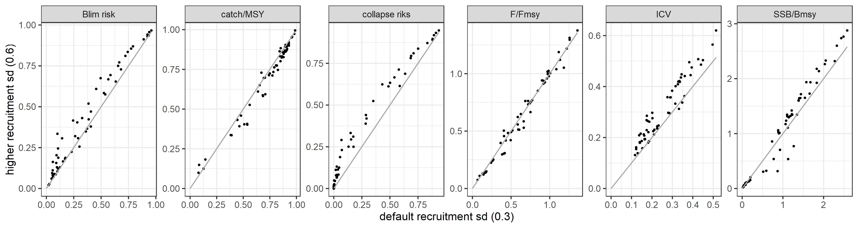
response 1
issues raised:
constant steepness h=0.75, should be species specific
more scenarios:
higher steepness h=0.9
higher recruitment uncertainty, double sd=0.3 to sd=0.6

Slide 12
response 1
constant steepness h=0.75, should be species specific
conclusions:
SSB trends similar
stocks with k≥0.38 still collapse, even earlier
sandeel (k=1) differs, but only because catch rule fails
summary statistics similar, no major trend/bias
repeating penalised regression model: still k most important
conclusion hold sensitivity test

Slide 13
paper submitted to ICES Journal of Marine Science
issues raised (II):
constant steepness h=0.75, should be species specific

Slide 14
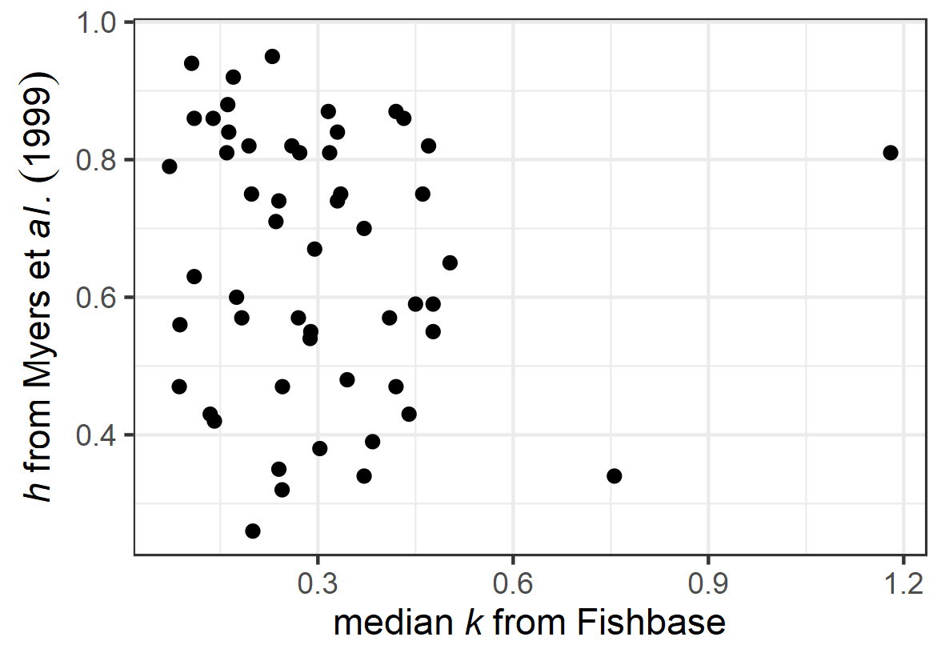
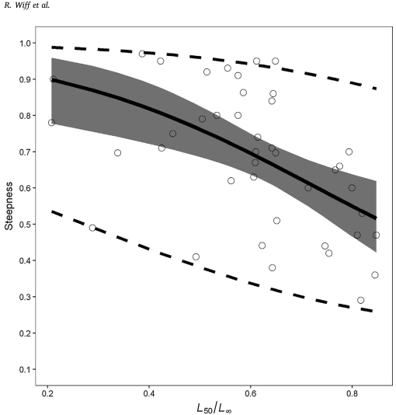
response 2
data-limited stocks: steepness unknown
no clear relationship between h and life-history
h=0.75 adopted from Jardim et al. (2015)
Myers et al. (1999) estimated h for 57 species
Wiff et al. (2018) meta-analysis links h to L₅₀/L_{inf} via Logit link, but high uncertainty
Jardim et al. 2015. Harvest control rules for data limited stocks using length-based reference points and survey biomass indices. FishRes 171.
Myers et al. 1999. Maximum reproductive rate of fish at low population sizes. Can. J. Fish. Aquat. Sci. 56.
Wiff et al. 2018. Estimating steepness of the stock-recruitment relationship in Chilean fish stocks using meta-analysis. FishRes 200.

Slide 15
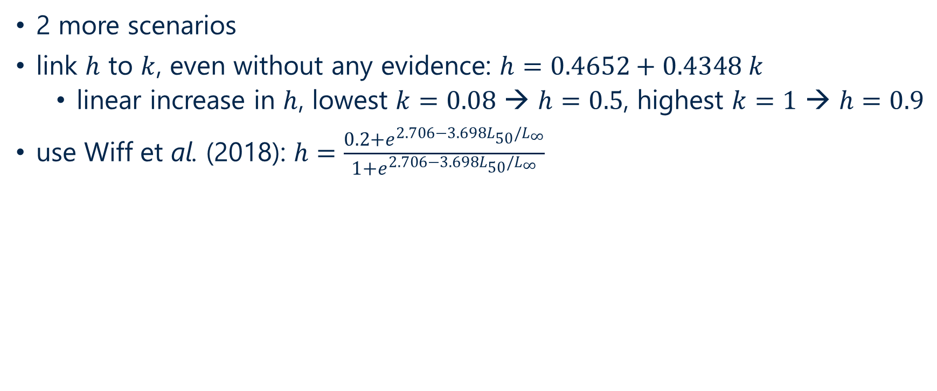
response 2
2 more scenarios
link to , even without any evidence:
linear increase in , lowest → , highest →
use Wiff et al. (2018):
stock | ang3 | rjc | smn | wlf | meg | lin | rjc2 | syc | sdv | ang | ang2 | pol | had | nep | mut
k | 0.08 | 0.09 | 0.11 | 0.11 | 0.12 | 0.14 | 0.14 | 0.15 | 0.15 | 0.18 | 0.18 | 0.19 | 0.2 | 0.2 | 0.21
h default | 0.75 | 0.75 | 0.75 | 0.75 | 0.75 | 0.75 | 0.75 | 0.75 | 0.75 | 0.75 | 0.75 | 0.75 | 0.75 | 0.75 | 0.75
h~L50/Linf | 0.76 | 0.66 | 0.55 | 0.91 | 0.80 | 0.68 | 0.75 | 0.58 | 0.65 | 0.63 | 0.71 | 0.73 | 0.83 | 0.82 | 0.84
h~k | 0.50 | 0.50 | 0.51 | 0.51 | 0.52 | 0.53 | 0.53 | 0.53 | 0.53 | 0.54 | 0.54 | 0.55 | 0.55 | 0.55 | 0.56
stock | sbb | ple | syc2 | arg | tur | gut | whg | bll | lem | ane | jnd | sar | her | san
k | 0.22 | 0.23 | 0.23 | 0.23 | 0.32 | 0.32 | 0.38 | 0.38 | 0.42 | 0.44 | 0.47 | 0.6 | 0.606 | 1
h default | 0.75 | 0.75 | 0.75 | 0.75 | 0.75 | 0.75 | 0.75 | 0.75 | 0.75 | 0.75 | 0.75 | 0.75 | 0.75 | 0.75
h~L50/Linf | 0.74 | 0.78 | 0.48 | 0.50 | 0.75 | 0.70 | 0.60 | 0.74 | 0.60 | 0.60 | 0.64 | 0.66 | 0.63 | 0.76
h~k | 0.56 | 0.57 | 0.57 | 0.57 | 0.60 | 0.60 | 0.63 | 0.63 | 0.65 | 0.66 | 0.67 | 0.73 | 0.73 | 0.90

Slide 16
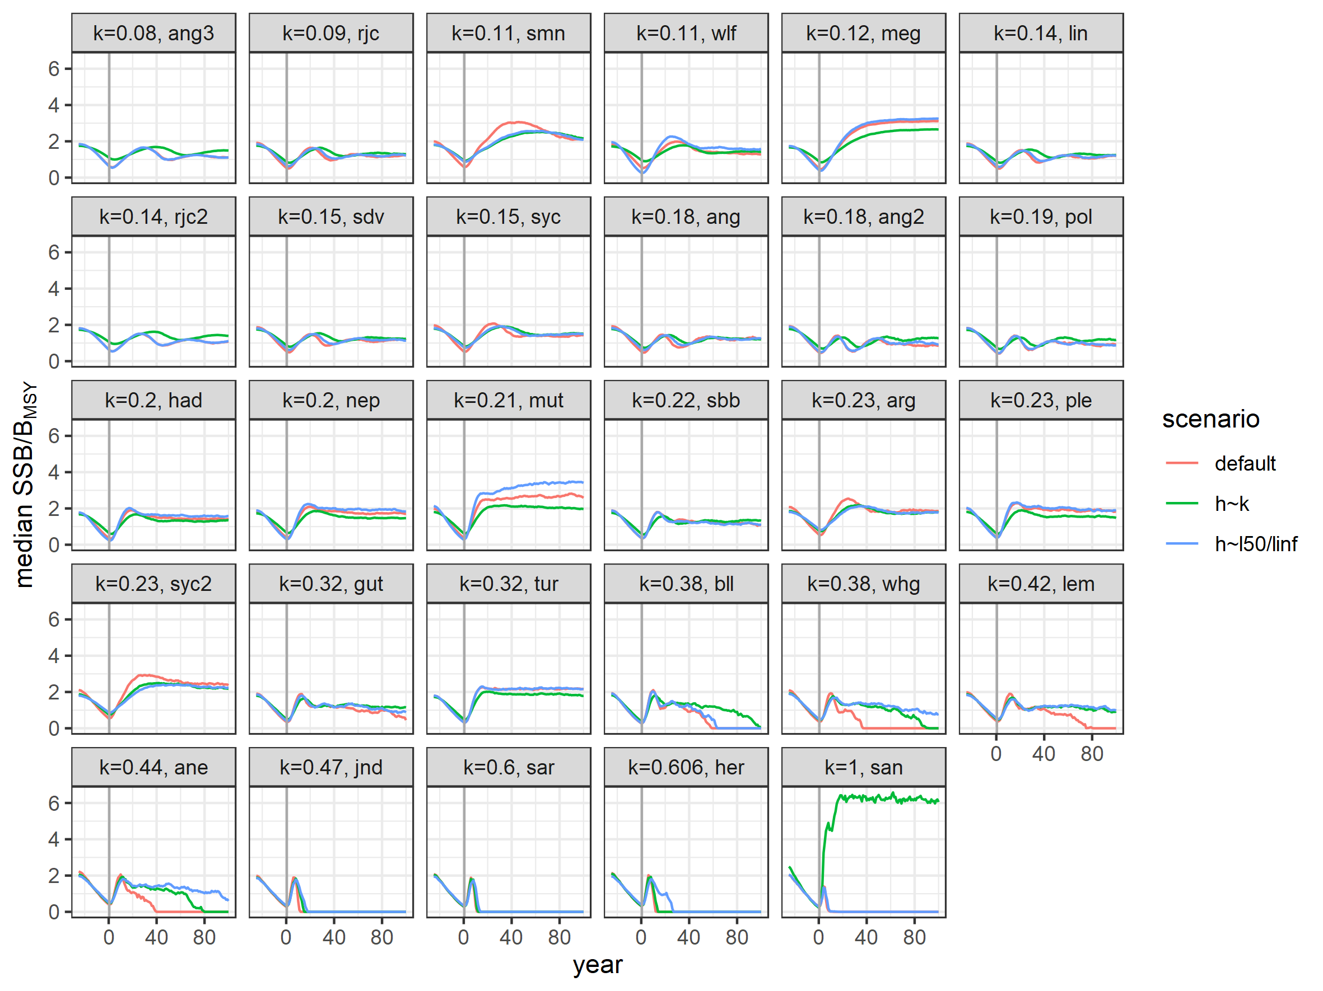
response 2

Slide 17
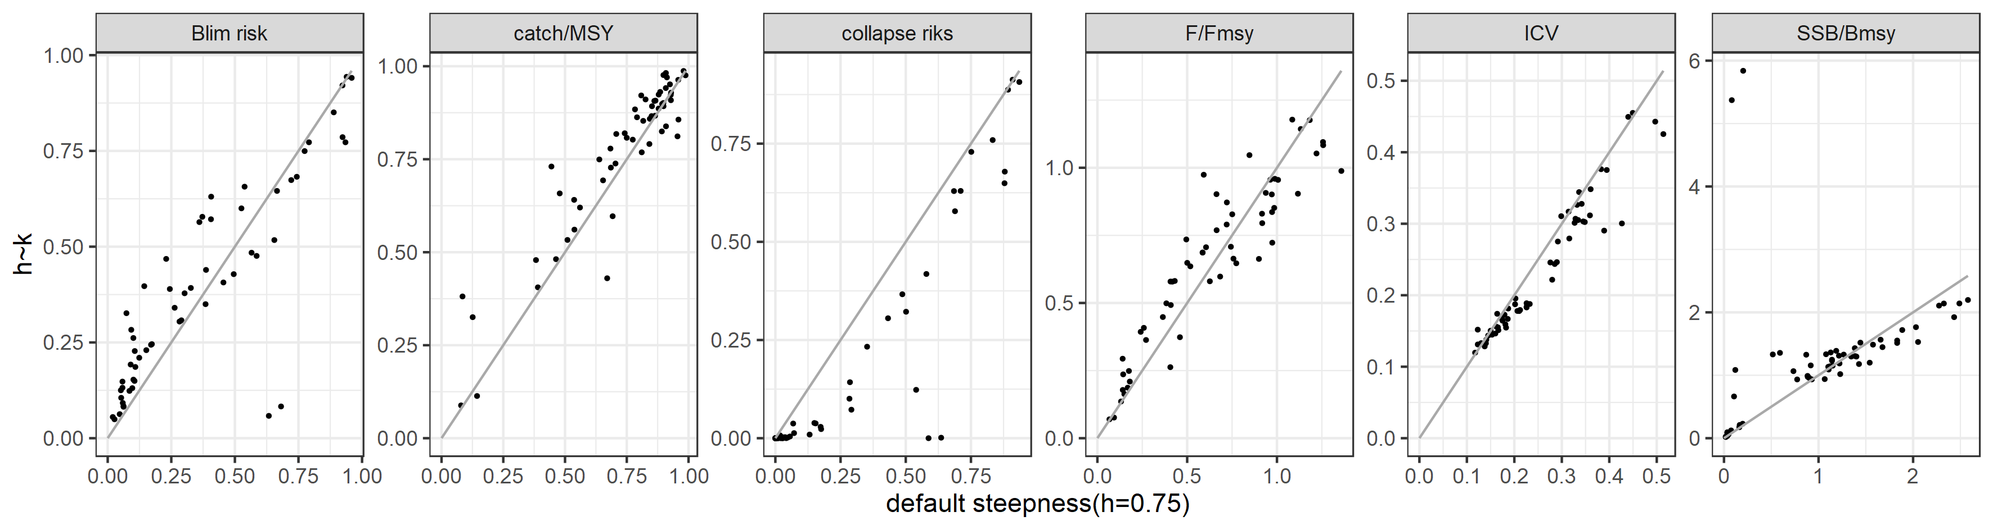
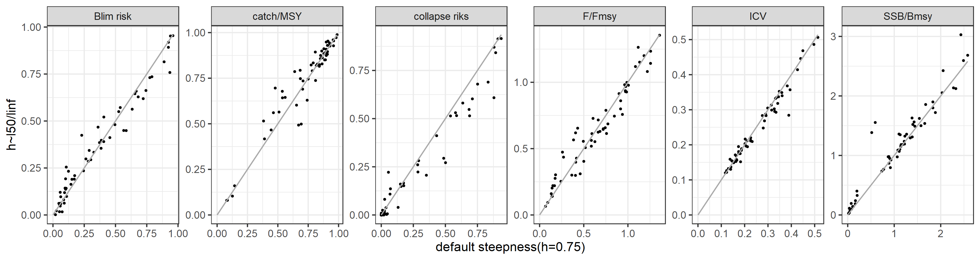
response 2

Slide 18
response 2
constant steepness h=0.75, should be species specific
conclusions:
SSB trends similar
stocks with k≤0.32 almost identical
stocks with 0.38≤ k≤0.44 transition collapse/delayed/survived
stocks with k≤0.32 still collapse
sandeel (k=1) differs, but only because catch rule fails
summary statistics similar, no major trend/bias
conclusion hold sensitivity test

Slide 19
paper submitted to ICES Journal of Marine Science
issues raised (III):
not robust towards steepness
steepness not high enough for h~k
recruitment to high for sandeel
…
no discussion about performance vs life-history

Slide 20
next?
we believe the results are robust to steepness assumptions
no steepness data available & no robust correlations with life-history parameters in empirical data
work is important for ICES WKLIFE

